Slide 1
Software Engineering Waterfall model

Slide 2
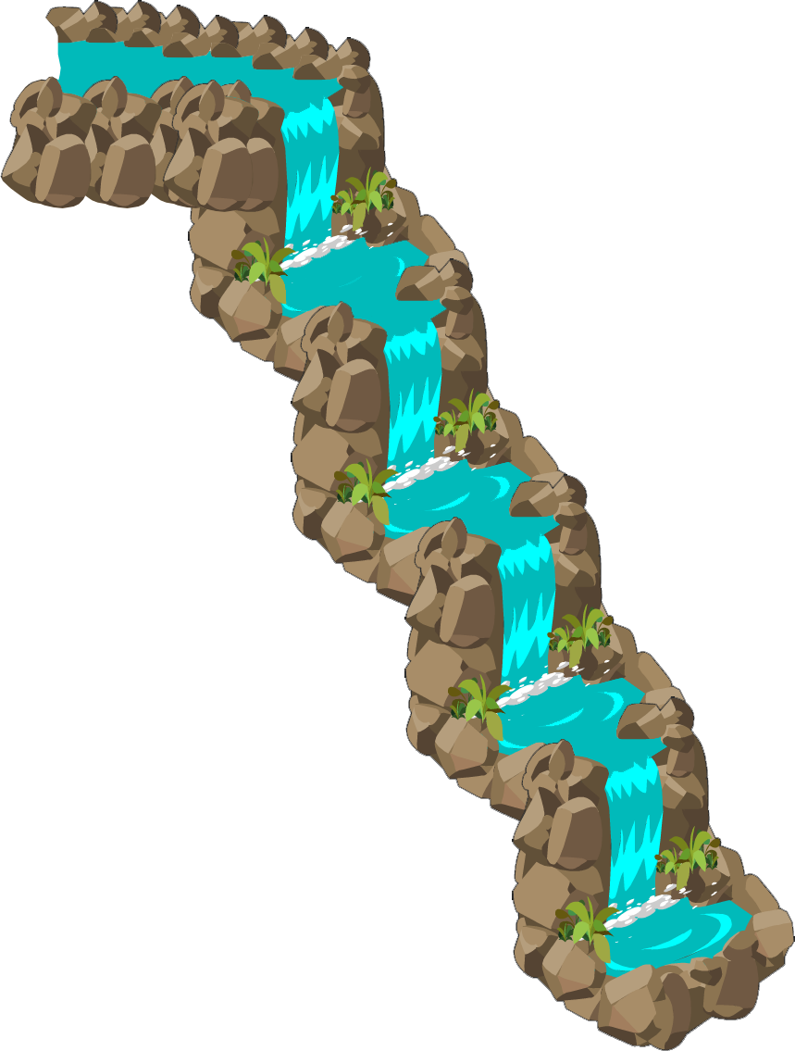
Waterfall - the „traditional“ model
Linear, sequencial model
Father of all models
1970 IEEE paper „Management the Development of Large System Software“ by Winston W. Royce
MIL-STD-2167
Requirements
Design
Implementation
WTF?
Verification
Maintenance
Notes:
Waterfall is pure example of a linear, sequencial model. Like a real waterfall which fills lower level pool before flowing further – each phase must be completed before starting another.
The model is rarely used nowadays, but it is called a father of all models and it is necessary to understand this simple model before studying other models.
The model was formaly presented in IEEE paper „Management the Development of Large System“ by Winston Royce. Actually, the idea of the article was to present an iterative model that relies on prototyping and Waterfall model served as an example of a flawed, non-working model. 2 things facilitated the spread of a model: (1) at that time there was a lack of easily understandable methodologies to govern software development and (2) the Department of Defence included that simplistic model from the paper into standard MIL-STD-2167. Soon DoD updated the recommendations, but the waterfall model already gone viral.

Slide 3
Waterfall model
Maintenance
Verification
Implementation
Requirements
Design
phase
Work products
Notes:
Each activity in watterfall model should finish completely before starting the new one. In the beginning the requirements are specified and the requirement specification documents are provided for a design phase. In a design phase the architect creates the whole software system design in a similar way the architect creates a complete building scheme. Therefore it relates to a Big UpFront Design term. The created design is provided to the Implementation phase. The outcome is a software which is tested in a verification phase. After product is verified and accepted – it is deployed and the maintenance phase starts. Such a model is really hard to use practically therefore a slight modification is proposed for that model.

Slide 4
Waterfall model with feedback loops
Maintenance
Verification
Implementation
Requirements
Design
phase
Work products
Notes:
The modification includes feedback loops – from one phase one can go back one phase. For example, if in a design phase becomes apparent that some functial or non-functial requirements are not realistic then these requirements are negotiated with customer and updated. If, during the implementation a design mistake comes up, then the software design is tweaked and implementation continues. In such a way a design stays correct.

Slide 5
When to use this model?
The requirements are known and stable for the upfront design.
The domain is well-known.
The technologies are well-understood.
Good for large software development that includes development at several sites?
Notes:
There are several pre-conditions which need to be met so that the model could be implemented.
The requirements should be known at the start of the project in order to do a big upfront design. The requirements should be stable to avoid the changes in the latest stages.
For the purpose the software application domain must be well known.
The technologies must be well understood in order to design everything upfront and avoid changes in later phases.
These pre-conditions makes it challenging to implement waterfall model. Still some researchers and practitioners discuss that this model is good for large systems engineering projects where a system is developed at several sites.
In those circumstances, the plan-driven nature of the waterfall model helps coordinate the work.

Slide 6
The challanges
All the requirements are not known at the start of the project.
The domain is not well-known.
The technologies are not well-understood.
The process is not flexible - changes are difficult to implement.
The workable software will be available only in the latest stages of development.
Notes:
As mentioned before, it is very hard to implement such a process model, because of the real-world conditions.
First of all – the requirements should be known completely before designing the system which is possible only in the rare cases and only few business systems have stable requirements.
For the requirements to be known – the software application domain must be well-known for the developers. This can be true if developers are working for years in the same domain.
The technologies are evolving normally very fast. Therefore the technologies that are well-understood might be already outdated.
Also, there is the criticism regarding customer involvement. Because of the waterfall nature, the workable software can be demonstrated only in the latest stages of development. There is a risk, that critical issues might be noticed by the customer only in the latest stages.

Slide 7

Key points
The waterfall model – the father of all models.
It is linear and sequencial model – each phase must be finished before another starts.
The model is mostly impractical.
Good for large systems engineering projects where a system is developed at several sites?
Notes:
The model is rarely used nowadays, but it is called a father of all models and it is necessary to understand this simple model before studying other models.
Waterfall is pure example of a linear, sequencial model. Each phase must be finished before another starts
The model is mostly impractical – domain, technologies and requirements must be well-known before project starts. It is not flexible and lacks customer involvement.
Some researchers and practitioners discuss that this model, at least partially, can be used for large systems engineering projects where a system is developed at several sites. In those circumstances, the plan-driven nature of the waterfall model helps coordinate the work.

Slide 8
Thank for your attention!

